Slide 1
ADAPTIVE SOFTWARE ENGINEERING (24CI3201)
AI-AcadPredict : AI-Integrated Adaptive Academic Project Collaboration & Risk Prediction Platform
Group-05
Team Members
2420030099 B. Srihitha
2420030162 V. Sai Dhanush
2420030171 R.L.S Giridhar
2420030773 Maha Lakshmi
Under the Esteemed Guidance of
Dr. G. Lavanya

Slide 2
Contents
Abstract
Introduction
Literature Survey
Problem Statement and Objectives
Existing System and Proposed System
Hardware and Software Requirements
System Workflow and Modules
Implementation and Results
Conclusion
Future Scope

Slide 3
Problem Statement
Problem Statement:
Academic project management requires continuous monitoring of tasks, milestones, deadlines, and student progress. Traditional manual monitoring makes it difficult to identify potential project delays at an early stage. Existing systems may lack integrated machine learning-based risk prediction capabilities. AI-AcadPredict addresses this challenge by analyzing project-related attributes using machine learning techniques. The system classifies project delay risk into LOW, MEDIUM, and HIGH categories. It aims to support proactive monitoring and timely intervention throughout the academic project lifecycle.
Motivation
To identify potential project delays at an early stage.
To analyze project progress using machine learning.
To support proactive monitoring and timely intervention.
To integrate a Random Forest-based prediction model with a FastAPI service.
To provide a foundation for future adaptive alerts and academic project management.

Slide 4
Objectives
Objectives
To develop an integrated academic project management platform for managing projects, teams, tasks, and milestones.
To develop a machine learning model that predicts academic project delay risk as LOW, MEDIUM, or HIGH.
To preprocess project data and train a Random Forest Classifier using relevant project features.
To evaluate the model using accuracy, precision, recall, F1-score, and a confusion matrix.
To save the trained model using Joblib and provide predictions through a FastAPI service.
To integrate the AI prediction service with the backend for project risk assessment.
To support future adaptive reminders and risk-based alerts for students, faculty, and coordinators.
To improve project monitoring by identifying potential delays and supporting timely intervention.

Slide 5
Literature Survey
Authors | Title of the Paper | Methodology | Inferences | Limitation / Future Work
Wang, J. & Yu, Y. (2025) | Machine Learning Approach to Student Performance Prediction of Online Learning | • Machine learning-based prediction • Student academic/learning data • Data preprocessing and predictive modeling | • ML can identify patterns in educational data. • Predictive models can support early identification of students requiring attention. | • Focuses mainly on student performance rather than academic project delays. • Future work can explore project-level prediction and intervention.
Mandapatti, J.K. (2025) | Machine Learning Models for Predicting Software Project Delays in Large Development Teams | • Historical project data • Project activity and team-related features • Machine learning models for delay prediction | • Project activity data can be used to predict project delays. • ML can support early identification of scheduling risks. | • Focuses on software development teams rather than academic projects. • Future work can adapt delay prediction to educational project environments.
Chauhan, N. (2025) | Adaptive Scheduling: Applying AI and Machine Learning to Optimize Project Timelines and Resource | • AI and machine learning • Dynamic scheduling • Predictive models • Real-time project data | • AI/ML can support adaptive project scheduling. • Prediction can be combined with project-management actions to respond to changing conditions. | • Focuses mainly on scheduling and resource optimization. • Future work can integrate academic project monitoring, risk prediction, and adaptive notifications.

Slide 6
Existing System vs Proposed System
Existing System / Approach | Problem Gap Identification | Our Proposed Solution
1. Traditional Academic Project Tracking – Existing academic project processes commonly use spreadsheets, periodic reviews, and manual progress tracking to monitor student projects. | Manual tracking can make it difficult to identify delayed projects early. Faculty and coordinators may need to check multiple projects individually. | Centralized Academic Project Platform – AI-AcadPredict provides a centralized platform for students, faculty, and coordinators to manage projects, teams, tasks, milestones, reviews, and progress.
2. Student Performance Prediction – Existing research uses machine learning techniques to analyze academic data and predict student performance or outcomes. | Student performance prediction does not directly address academic project delay risk or project-level progress conditions. | AI-Based Project Delay Risk Prediction – AI-AcadPredict uses project-related activity features and a Random Forest model to classify projects into Low, Medium, and High delay risk.
3. Project Delay Prediction – Existing research applies machine learning to historical project data to identify potential schedule delays. | General project-delay prediction approaches are not specifically integrated into an academic project management workflow with automatic actions after prediction. | Adaptive Risk-Based Workflow – AI-AcadPredict connects the predicted risk with predefined adaptive rules. Depending on the risk level, the system can trigger reminders, faculty alerts, and coordinator notifications for timely intervention.

Slide 7
Hardware and Software requirements
Category | Technology
Frontend | React.js
Backend | Java + Spring Boot
Database | MySQL
Authentication | Spring Security + JWT
AI/ML | Python
ML Library | Scikit-learn
ML Algorithm | Random Forest
AI API | FastAPI
Model Storage | Joblib
Version Control | Git + GitHub
Build Tool | Maven
API Testing | Postman
Agile Tool | Jira
Containerization | Docker

Slide 8
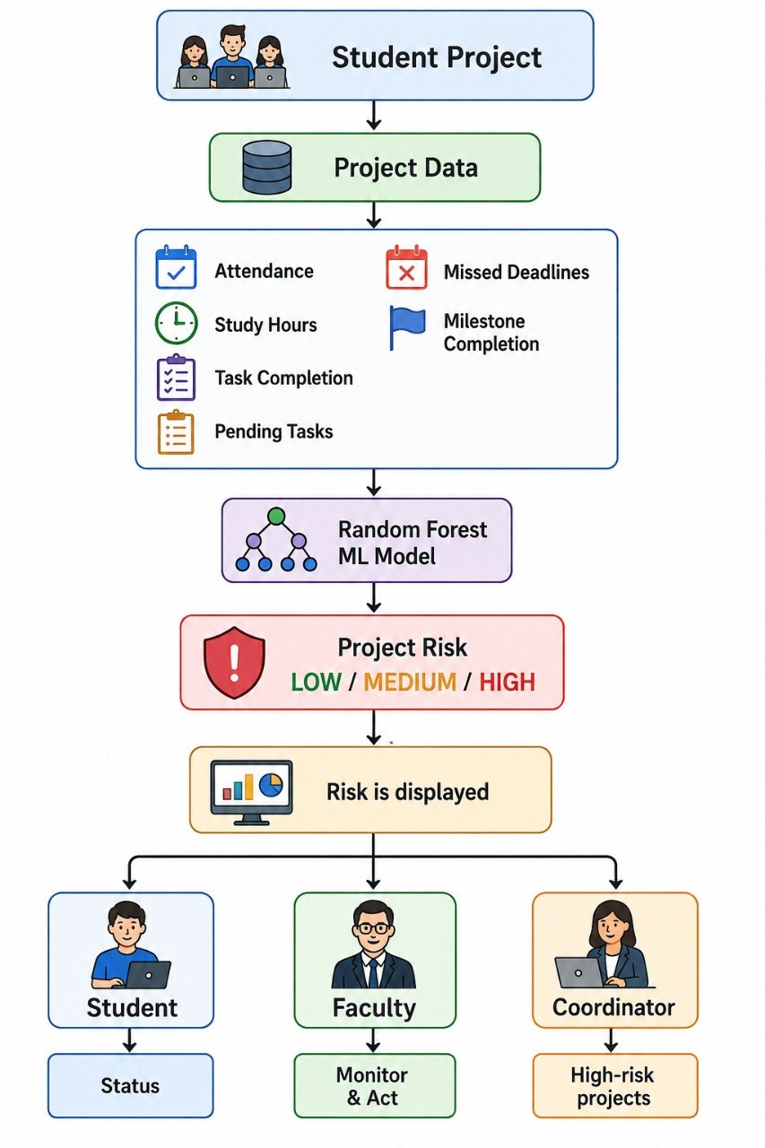
System Workflow

Slide 9
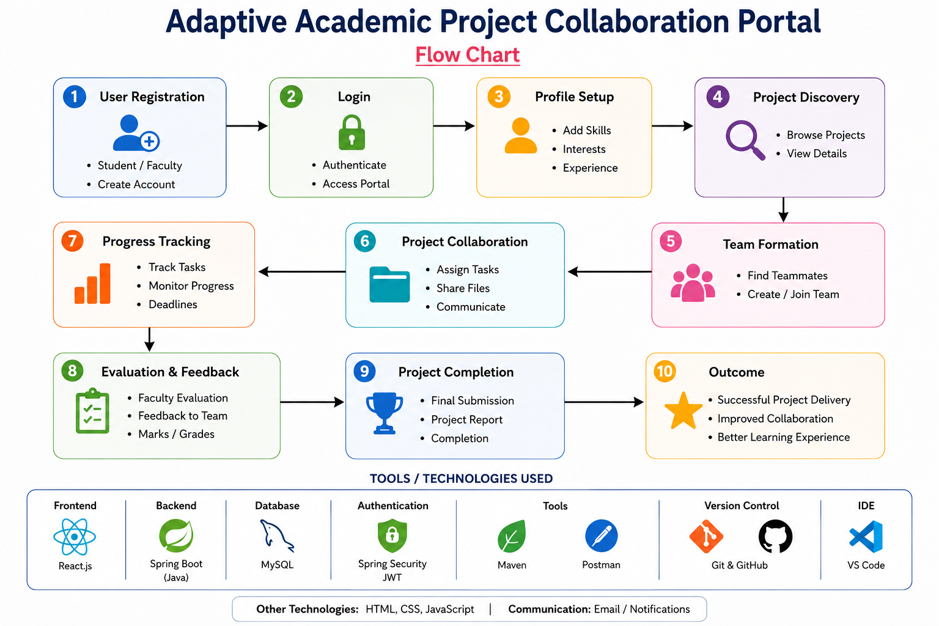
Flow Chart

Slide 10
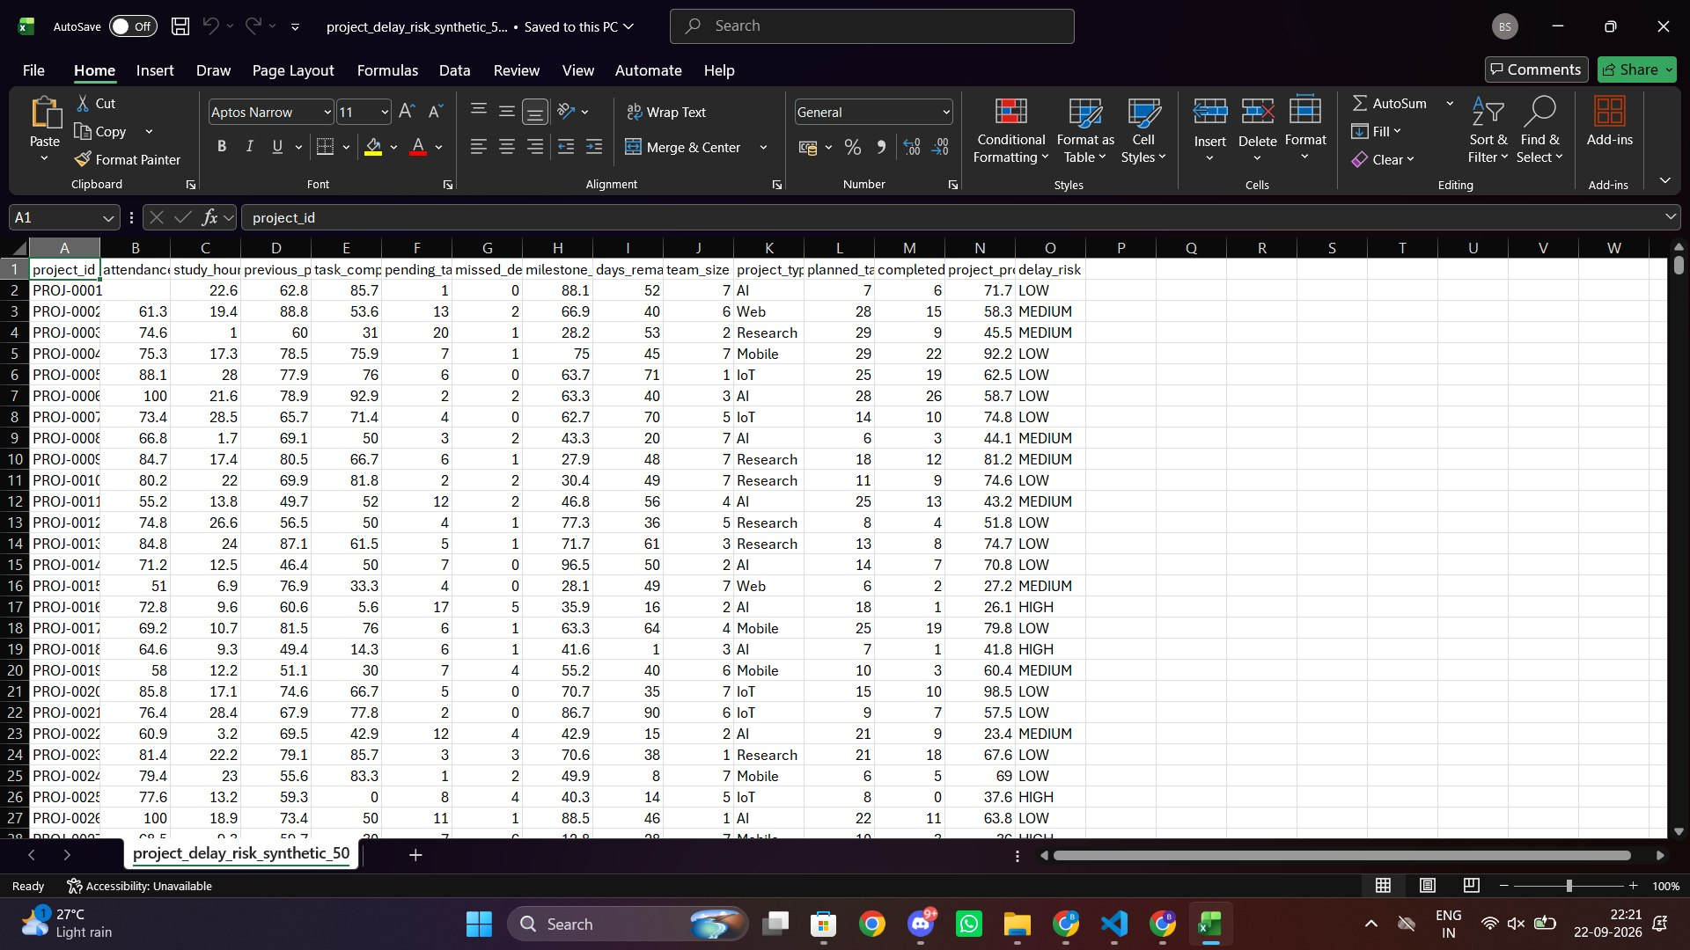
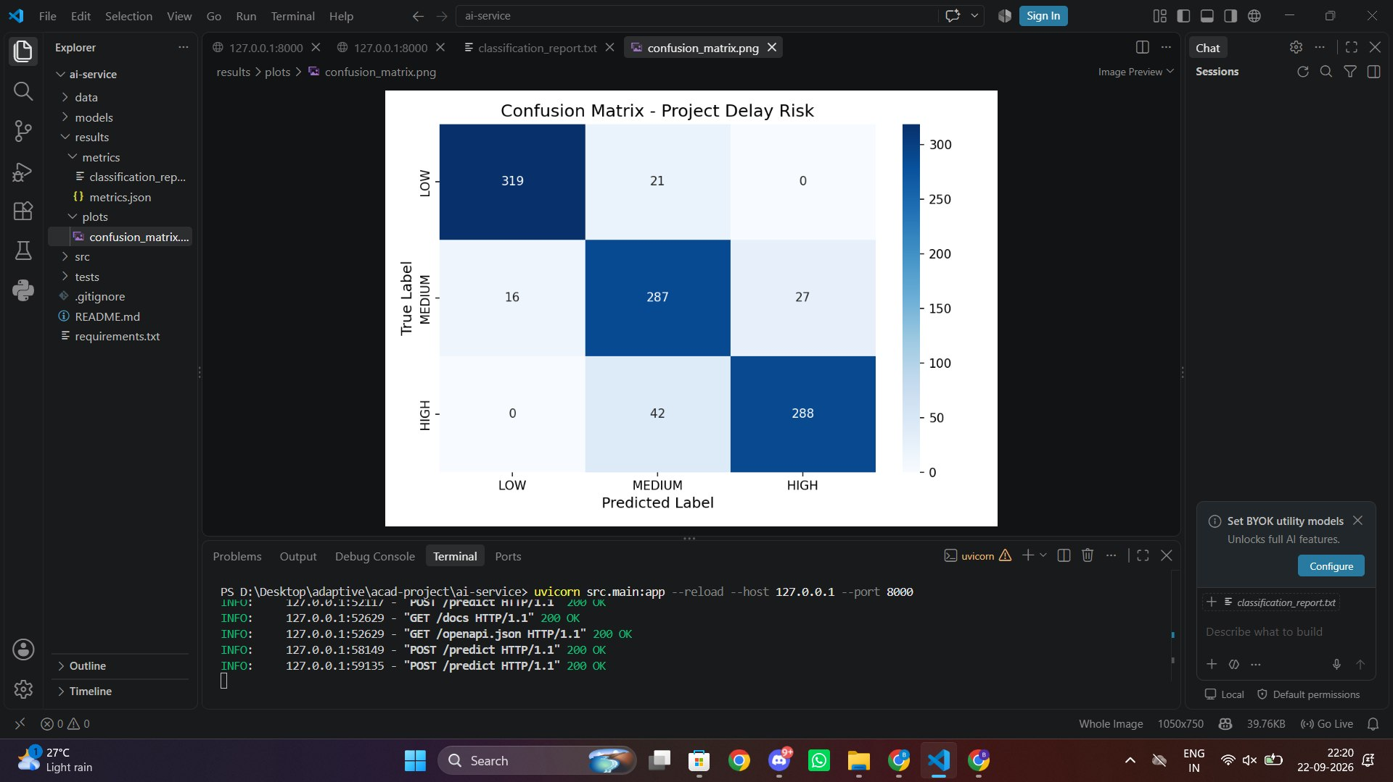
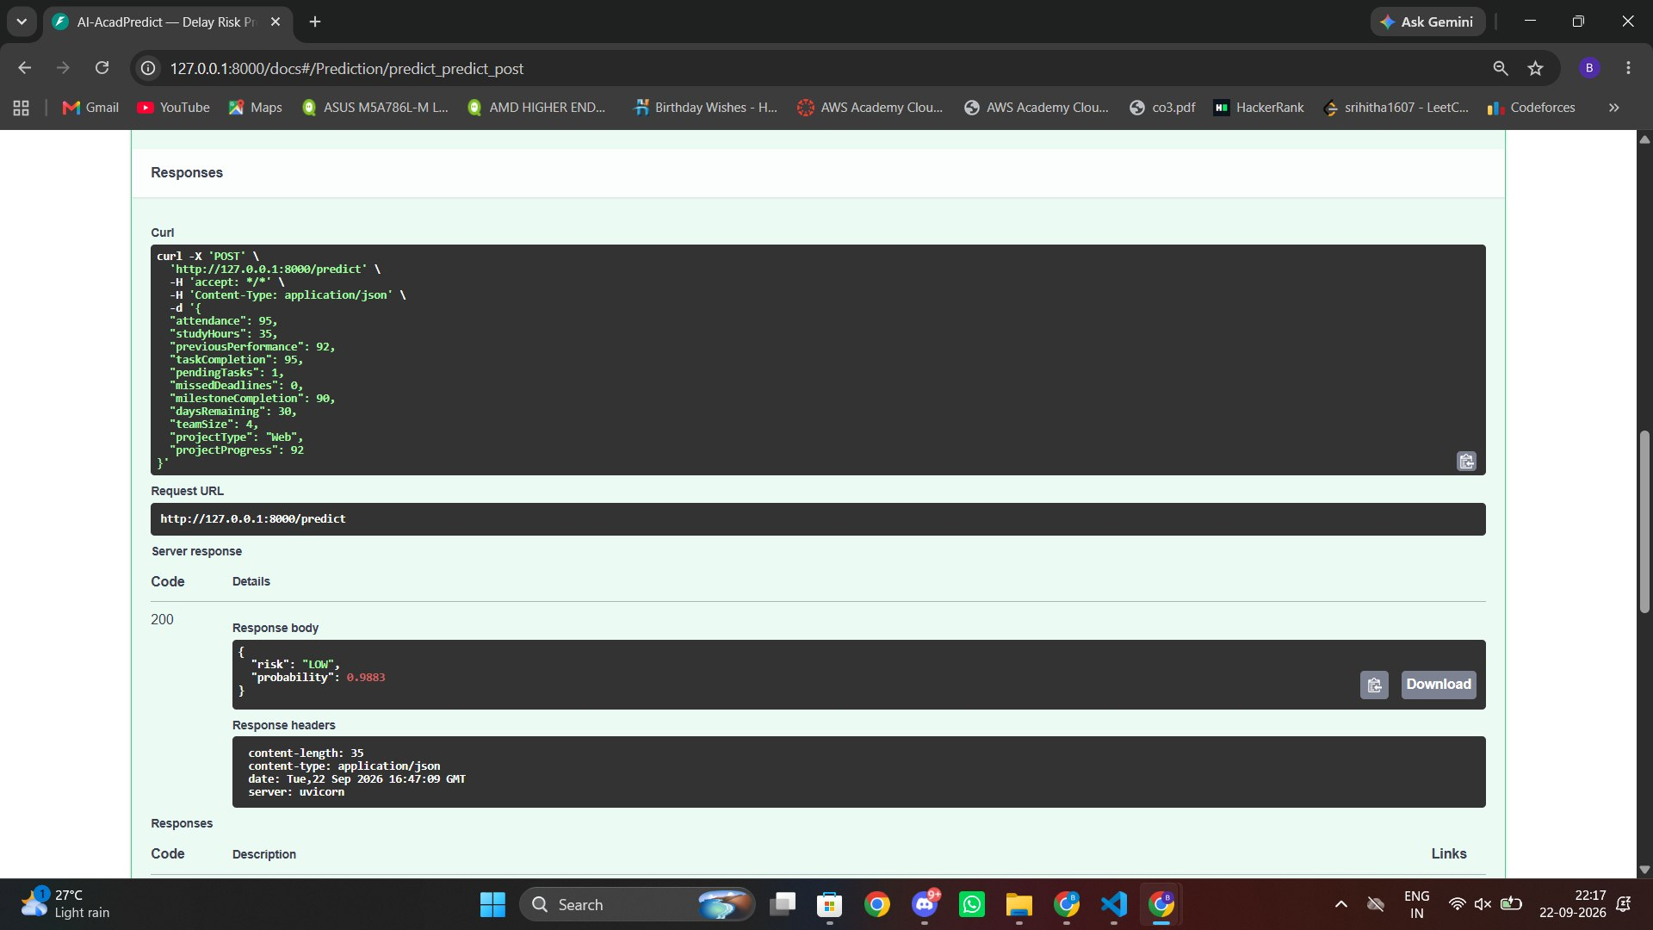
AI Integration
Machine Learning Objective
Predict the risk of academic project delay.
Input — X
The model can use project/activity features such as:
Attendance Percentage
Task Completion Percentage
Pending Tasks
Missed Deadlines
Milestone Completion
Study/Activity Hours
Previous Academic Performance
Output — Y
Low Risk
Medium Risk
High Risk
Model: Random Forest Classifier
Evaluation
Accuracy
Precision
Recall
F1-Score
Confusion Matrix

Slide 11
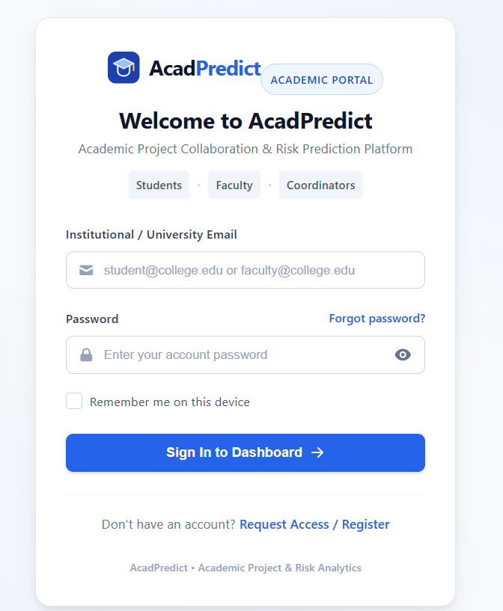
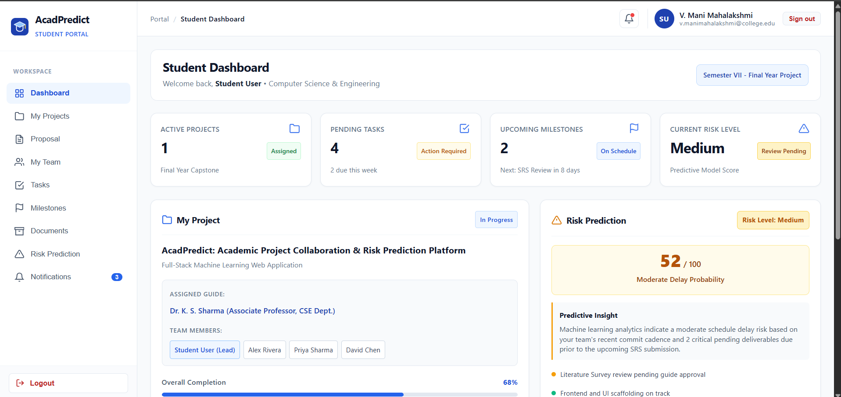
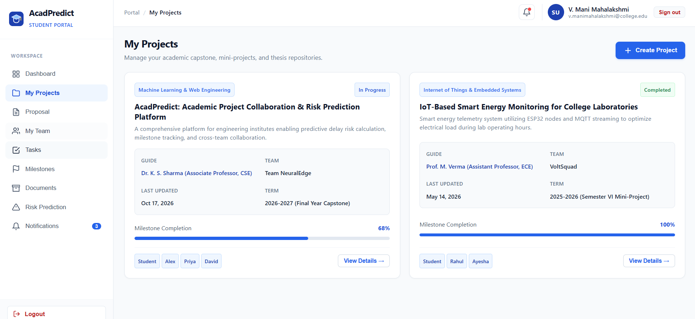
Main Modules
1. User & Authentication
Registration
Login
JWT authentication
Role-based access
2. Project Management
Project proposal
Project details
Project status
3. Team Management
Create team
Join team
Team members
4. Task & Milestone Management
Create tasks
Update tasks
Track milestones
Monitor progress
5. Faculty Module
Review proposals
Approve/reject
Give feedback
Monitor projects
6. AI Risk Prediction
Process project data
Predict delay risk
Display risk level
7. Notification & Adaptive Module
Reminders
Faculty alerts
Coordinator escalation

Slide 12
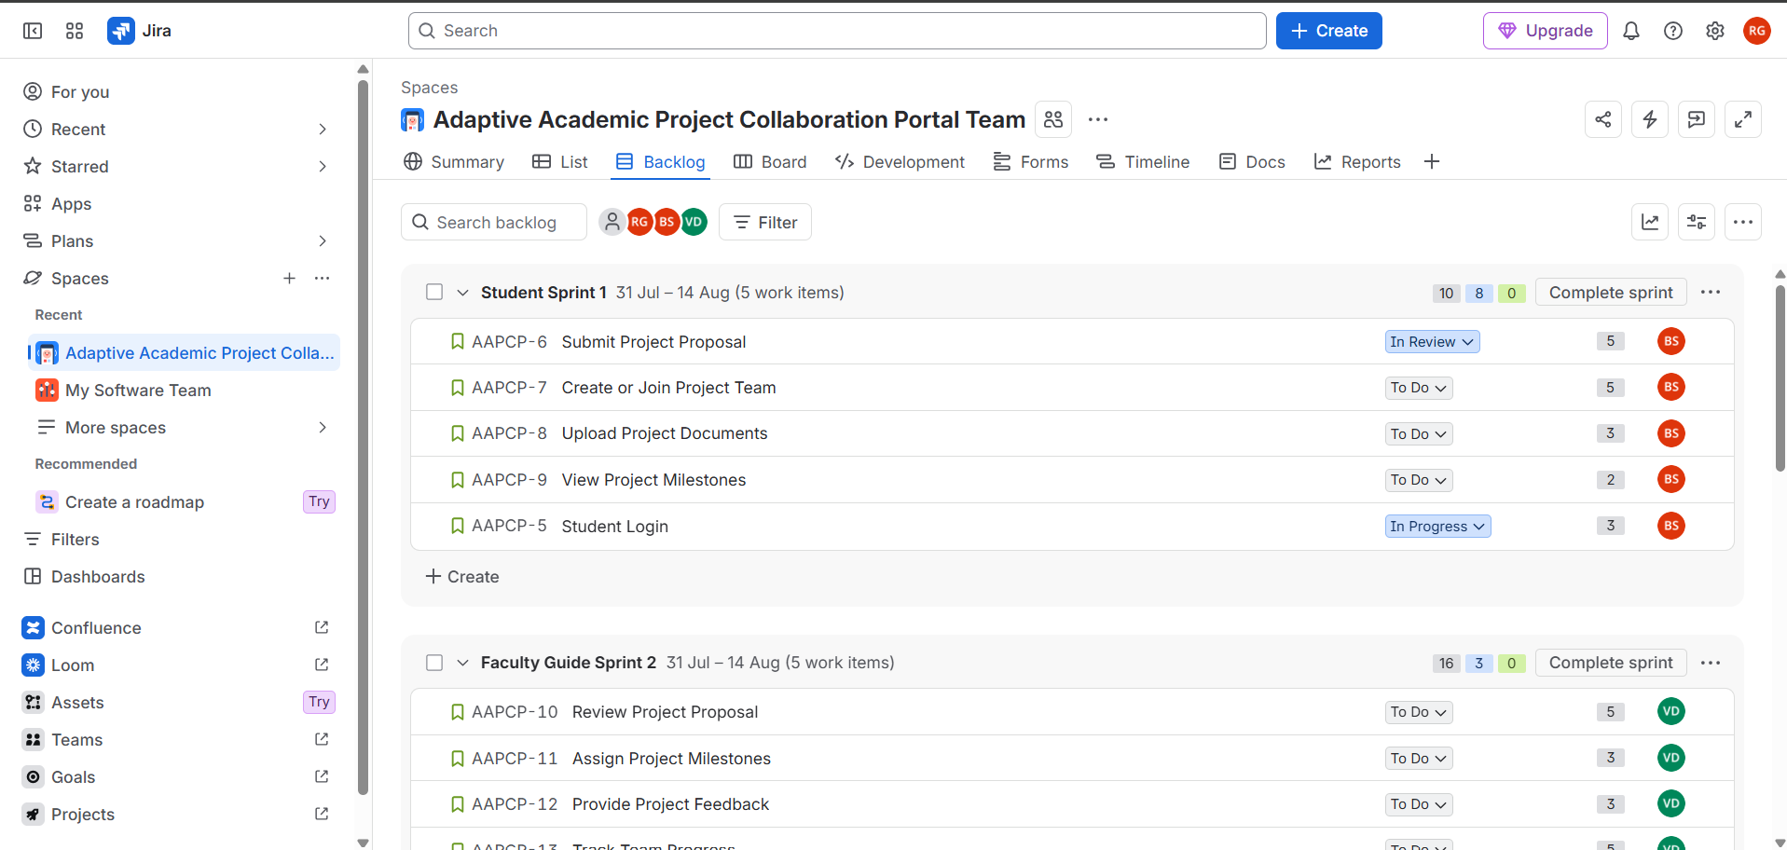
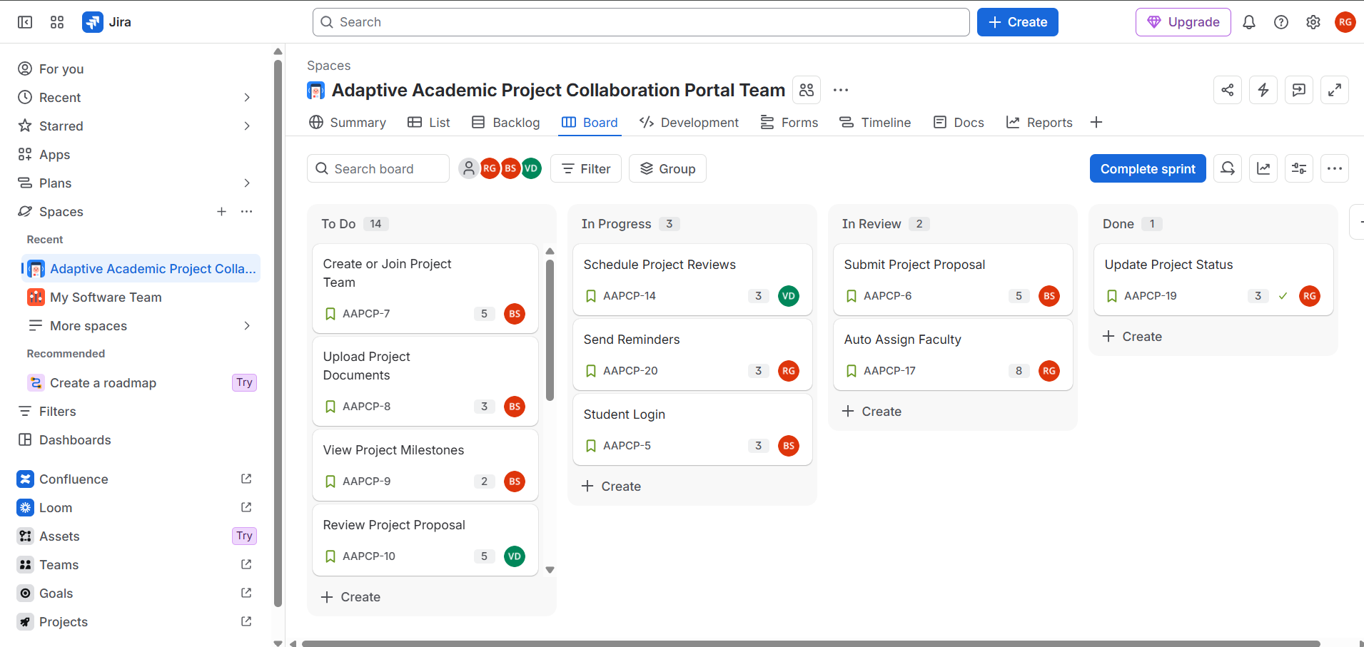
Scrum & Jira
Development Method: Scrum Framework
Jira Used For
Product backlog
User stories
Story points
Sprint planning
Task tracking
Progress monitoring
Current Jira Progress
Completed:
User stories created
Story points assigned
Product backlog prepared

Slide 13
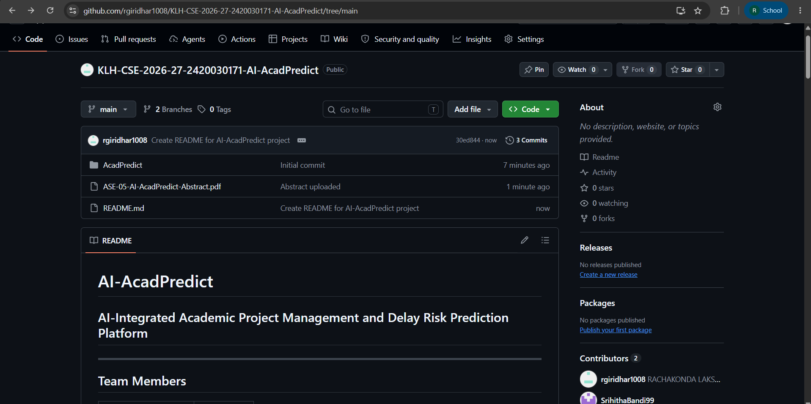
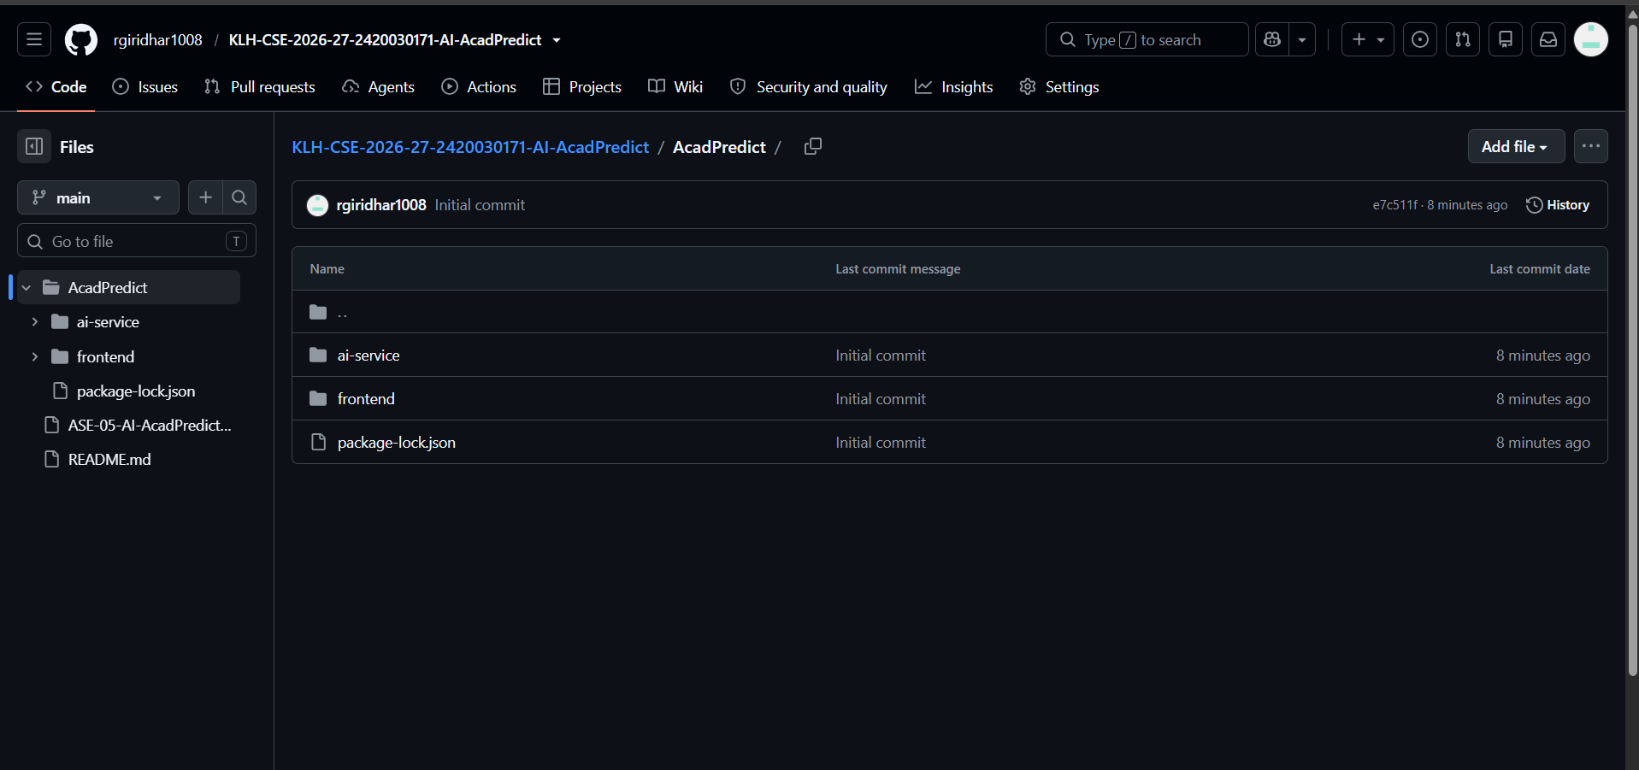
GitHub Progress
Repository
GitHub: AI-AcadPredict
Current Work
The repository contains the current development work for:
React.js frontend
AI/ML model
FastAPI AI service
Project documentation
User stories and project resources
Pending GitHub Work
Spring Boot backend
MySQL integration
Frontend–Backend connection
Backend–AI connection
Docker configuration
Final integrated application

Slide 14
Implementation Progress
Completed
Project title finalized
Team and roles identified
Project objectives finalized
AI integration defined
User stories created
Story points estimated
Jira backlog prepared
Technology stack finalized
React.js frontend developed
AI/ML service developed
FastAPI AI service implemented
Random Forest model implemented
In Progress
System architecture refinement
Database integration
Requirement refinement
Sprint development
Pending
Spring Boot backend development
Frontend–Backend integration
Backend–AI integration
MySQL integration
End-to-end system integration
Dockerization
Testing and debugging

Slide 15
Conclusion & Future Scope
Conclusion
AI-AcadPredict aims to provide an integrated platform for managing academic projects while using machine learning to identify potential project delays.
The current phase has established the project requirements, AI approach, technology stack, user stories, and Scrum backlog.
Future Scope
Complete frontend development
Implement Spring Boot backend
Develop MySQL database
Train and evaluate Random Forest model
Integrate FastAPI with the backend
Implement adaptive notifications
Perform complete system testing
Dockerize the application
Deploy the final application

Slide 16
Thankyou

